Slide 1


Slide 2

PROJECT OVERVIEW

Slide 3
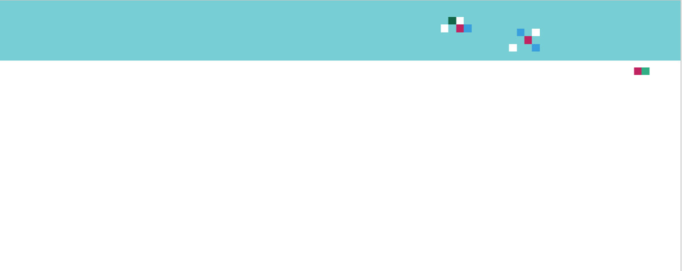
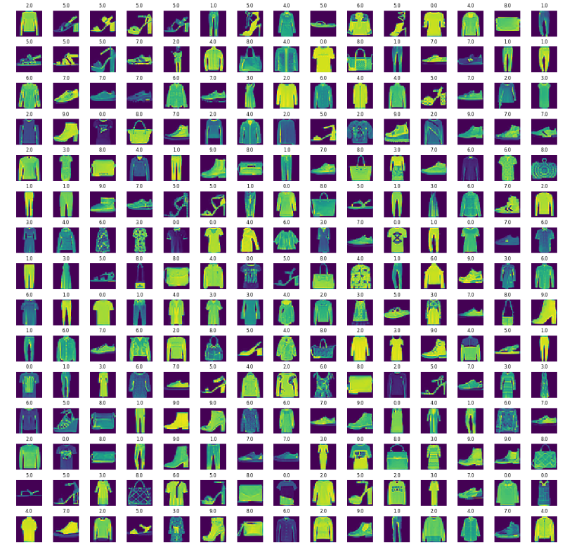
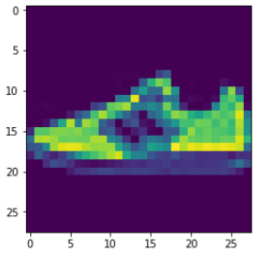
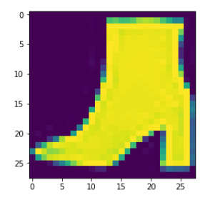
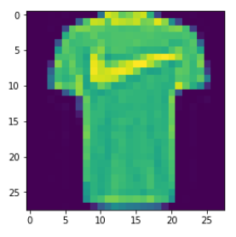
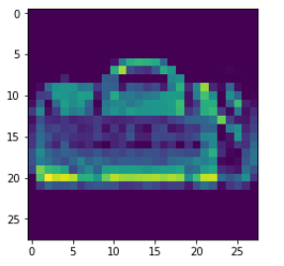
PROJECT OVERVIEW: INTRO TO IMAGE CLASSIFIERS
Image Classifiers work by predicting the class of items that are present in a given image.
For example, you can train a classifier to classify images of cats and dogs.
So when you feed a trained classifier an image of a dog, it can predict the label associated with the given image “label = dog”.
Let’s take a look at the fashion class dataset.
TARGET CLASS: 10
INPUT IMAGES
T-SHIRT/TOP
TROUSER
PULLOVER
DRESS
COAT
SANDAL
SHIRT
SNEAKER
BAG
ANKLE BOOT
CLASSIFIER
Fashion consists of 70,000 images
60,000 training
10,000 testing
Images are 28x28 grayscale

Slide 4
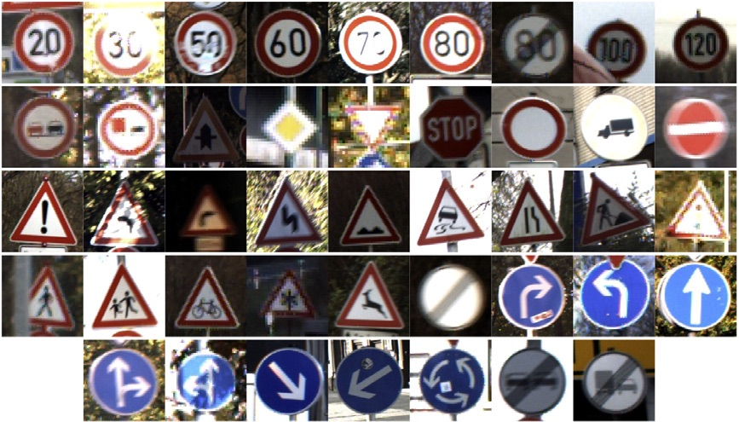
PROJECT OVERVIEW: CLASSIFY TRAFFIC SIGNS
Traffic sign classification is an important task for self driving cars.
In this project, a Deep Network known as LeNet will be used for traffic sign images classification.
The dataset contains 43 different classes of images.
Classes are as listed below:
( 0, b'Speed limit (20km/h)') ( 1, b'Speed limit (30km/h)') ( 2, b'Speed limit (50km/h)') ( 3, b'Speed limit (60km/h)') ( 4, b'Speed limit (70km/h)')
( 5, b'Speed limit (80km/h)') ( 6, b'End of speed limit (80km/h)') ( 7, b'Speed limit (100km/h)') ( 8, b'Speed limit (120km/h)') ( 9, b'No passing')
(10, b'No passing for vehicles over 3.5 metric tons') (11, b'Right-of-way at the next intersection') (12, b'Priority road') (13, b'Yield') (14, b'Stop')
(15, b'No vehicles') (16, b'Vehicles over 3.5 metric tons prohibited') (17, b'No entry')
(18, b'General caution') (19, b'Dangerous curve to the left')
(20, b'Dangerous curve to the right') (21, b'Double curve')
(22, b'Bumpy road') (23, b'Slippery road')
(24, b'Road narrows on the right') (25, b'Road work')
(26, b'Traffic signals') (27, b'Pedestrians') (28, b'Children crossing')
(29, b'Bicycles crossing') (30, b'Beware of ice/snow')
(31, b'Wild animals crossing')
(32, b'End of all speed and passing limits') (33, b'Turn right ahead')
(34, b'Turn left ahead') (35, b'Ahead only') (36, b'Go straight or right')
(37, b'Go straight or left') (38, b'Keep right') (39, b'Keep left')
(40, b'Roundabout mandatory') (41, b'End of no passing')
(42, b'End of no passing by vehicles over 3.5 metric tons')
Data Source: https://www.kaggle.com/meowmeowmeowmeowmeow/gtsrb-german-traffic-sign

Slide 5

CLASSIFY TRAFFIC SIGNS
The dataset consists of 43 different classes.
Images are 32 x 32 pixels
INPUT IMAGE
TARGET CLASSES
20km/h
50 km/h
100 km/h
Stop
Yield
CLASSIFIER
32
32

Slide 6
WHAT ARE CONVOLUTIONAL NEURAL NETWORKS (CNNS) AND HOW DO THEY LEARN?

Slide 7
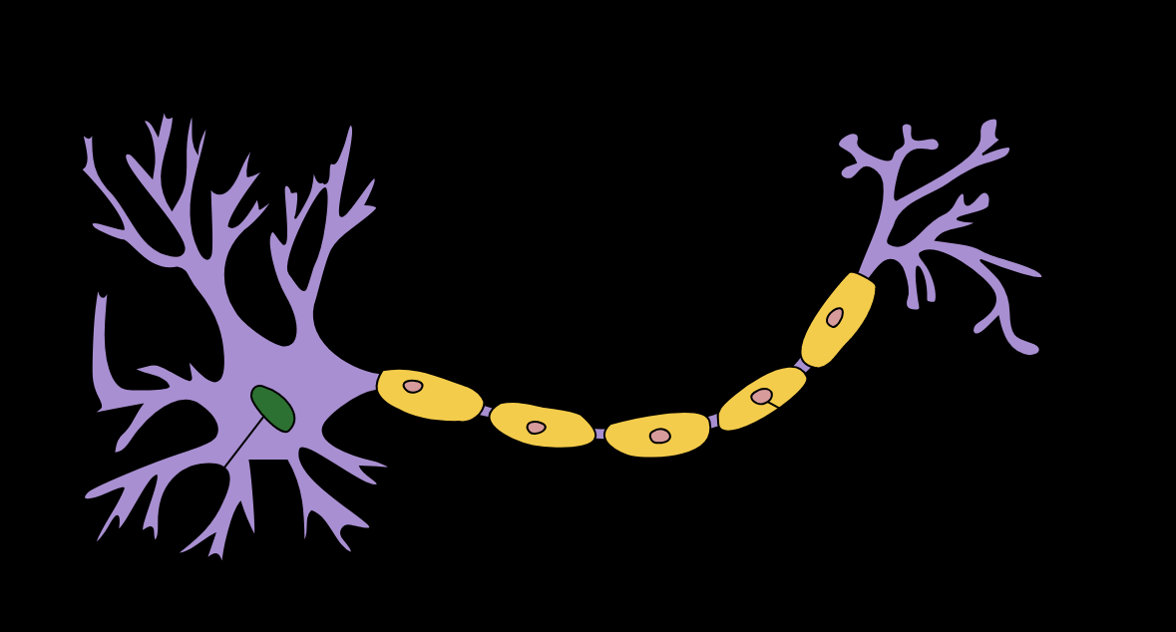
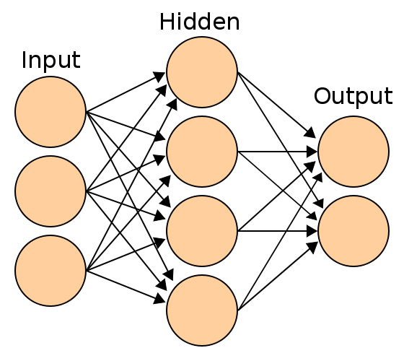
CONVOLUTIONAL NEURAL NETWORKS BASICS
The neuron collects signals from input channels named dendrites, processes information in its nucleus, and then generates an output in a long thin branch called the axon.
Human learning occurs adaptively by varying the bond strength between these neurons.
Photo Credit: https://commons.wikimedia.org/wiki/File:Artificial_neural_network.svg
Photo Credit: https://commons.wikimedia.org/wiki/File:Neuron_Hand-tuned.svg

Slide 8
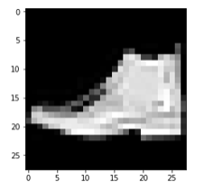
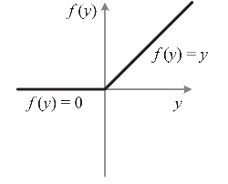
CONVOLUTIONAL NEURAL NETWORKS: ENTIRE NETWORK OVERVIEW
T-SHIRT/TOP
TROUSER
PULLOVER
DRESS
COAT
SANDAL
SHIRT
SNEAKER
BAG
ANKLE BOOT
CONVOLUTION
POOLING
FLATTENING
KERNELS/
FEATURE DETECTORS
POOLING FILTERS
CONVOLUTIONAL LAYER
POOLING LAYER (DOWNSAMPLING)
Photo Credit: https://commons.wikimedia.org/wiki/File:Artificial_neural_network.svg

Slide 9
FEATURE DETECTORS
Convolutions use a kernel matrix to scan a given image and apply a filter to obtain a certain effect.
An image Kernel is a matrix used to apply effects such as blurring and sharpening.
Kernels are used in machine learning for feature extraction to select most important pixels of an image.
Convolution preserves the spatial relationship between pixels.
FEATURE MAPS
KERNELS/
FEATURE DETECTORS

Slide 10
FEATURE DETECTORS
Live Convolution: http://setosa.io/ev/image-kernels/
FEATURE DETECTOR
0 | 1 | 1 | 0 | 1
1 | 0 | 0 | 0 | 1
1 | 1 | 0 | 0 | 0
0 | 1 | 1 | 1 | 0
0 | 0 | 1 | 0 | 1
1 | 0 | 0
0 | 1 | 0
0 | 1 | 0
1
1
1
3
1
1
2
3
1
FEATURE MAP
IMAGE

Slide 11
WHAT ARE CONVOLUTIONAL NEURAL NETWORKS (CNNS) AND HOW DO THEY LEARN? – PART 2

Slide 12

RELU (RECTIFIED LINEAR UNITS)
RELU Layers are used to add non-linearity in the feature map.
It also enhances the sparsity or how scattered the feature map is.
T-SHIRT/TOP
TROUSER
PULLOVER
DRESS
COAT
SANDAL
SHIRT
SNEAKER
BAG
ANKLE BOOT
CONVOLUTION
POOLING
FLATTENING
KERNELS/
FEATURE DETECTORS
POOLING FILTERS
CONVOLUTIONAL LAYER
POOLING LAYER (DOWNSAMPLING)
Photo Credit: https://commons.wikimedia.org/wiki/File:Artificial_neural_network.svg

Slide 13
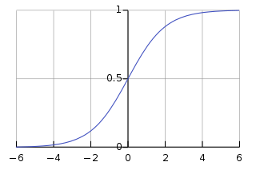

RELU (RECTIFIED LINEAR UNITS)
RELU Layers are used to add non-linearity in the feature map.
It also enhances the sparsity or how scattered the feature map is.
The gradient of the RELU does not vanish as we increase x compared to the sigmoid function
7 | 10 | -5 | 2 | 1
1 | 0 | 2 | 3 | -6
1 | 17 | -5 | 0 | 0
0 | 1 | 1 | 1 | 0
0 | 0 | -8 | 12 | 1
7 | 10 | 0 | 2 | 1
1 | 0 | 2 | 3 | 0
1 | 17 | 0 | 0 | 0
0 | 1 | 1 | 1 | 0
0 | 0 | 0 | 12 | 1
Photo Credit: https://commons.wikimedia.org/wiki/File:Artificial_neural_network.svg

Slide 14
POOLING (DOWNSAMPLING)
Pooling or down sampling layers are placed after convolutional layers to reduce feature map dimensionality.
This improves the computational efficiency while preserving the features.
Pooling helps the model to generalize by avoiding overfitting.
If one of the pixel is shifted, the pooled feature map will still be the same.
Max pooling works by retaining the maximum feature response within a given sample size in a feature map.
Live illustration : http://scs.ryerson.ca/~aharley/vis/conv/flat.html
1 | 1 | 3 | 4
3 | 6 | 2 | 8
3 | 9 | 1 | 0
1 | 3 | 3 | 4
6
MAX POOLING
6
8
FLATTENING
8
9
4
9
2x2
STRIDE = 2
4
Photo Credit: https://commons.wikimedia.org/wiki/File:Artificial_neural_network.svg

Slide 15
HOW TO IMPROVE NETWORK PERFORMANCE?

Slide 16
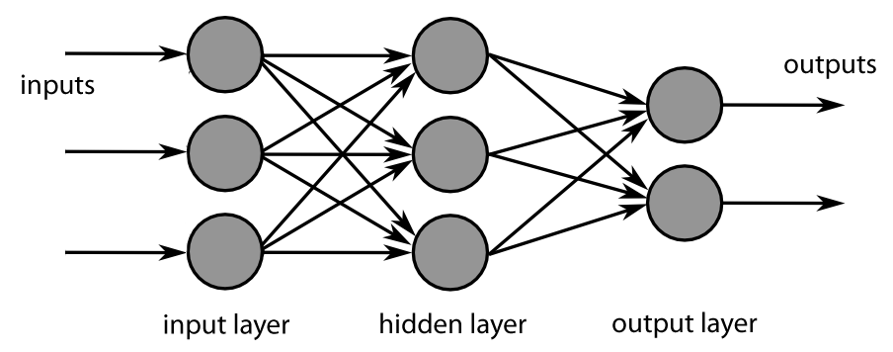
INCREASE FILTERS/DROPOUT
Improve accuracy by adding more feature detectors/filters or adding a dropout.
Dropout refers to dropping out units in a neural network.
Neurons develop co-dependency amongst each other during training
Dropout is a regularization technique for reducing overfitting in neural networks.
It enables training to occur on several architectures of the neural network
KERNELS/
FEATURE DETECTORS
64 INSTEAD OF 32
Photo Credit: https://fr.m.wikipedia.org/wiki/Fichier:MultiLayerNeuralNetworkBigger_english.png

Slide 17
CONFUSION MATRIX

Slide 18
CONFUSION MATRIX
TRUE CLASS
+
-
TYPE I ERROR
+
TRUE +
FALSE +
PREDICTIONS
FALSE -
TRUE -
-
TYPE II ERROR

Slide 19
CONFUSION MATRIX
A confusion matrix is used to describe the performance of a classiﬁcation model:
True positives (TP): cases when classiﬁer predicted TRUE (they have the disease), and correct class was TRUE (patient has disease).
True negatives (TN): cases when model predicted FALSE (no disease), and correct class was FALSE (patient do not have disease).
False positives (FP) (Type I error): classiﬁer predicted TRUE, but correct class was FALSE (patient did not have disease).
False negatives (FN) (Type II error): classiﬁer predicted FALSE (patient do not have disease), but they actually do have the disease

Slide 20
KEY PERFORMANCE INDICATORS (KPI)
Classiﬁcation Accuracy = (TP+TN) / (TP + TN + FP + FN)
Misclassiﬁcation rate (Error Rate) = (FP + FN) / (TP + TN + FP + FN)
Precision = TP/Total TRUE Predictions = TP/ (TP+FP) (When model predicted TRUE class, how often was it right?)
Recall = TP/ Actual TRUE = TP/ (TP+FN) (when the class was actually TRUE, how often did the classiﬁer get it right?)

Slide 21
PRECISION Vs. RECALL EXAMPLE
TRUE CLASS
+
-
TP = 1
FP = 1
+
PREDICTIONS
-
FN = 8
TN = 90
Classiﬁcation Accuracy = (TP+TN) / (TP + TN + FP + FN) = 91%
Precision = TP/Total TRUE Predictions = TP/ (TP+FP) = ½=50%
Recall = TP/ Actual TRUE = TP/ (TP+FN) = 1/9 = 11%

Slide 22
LENET NETWORK

Slide 23
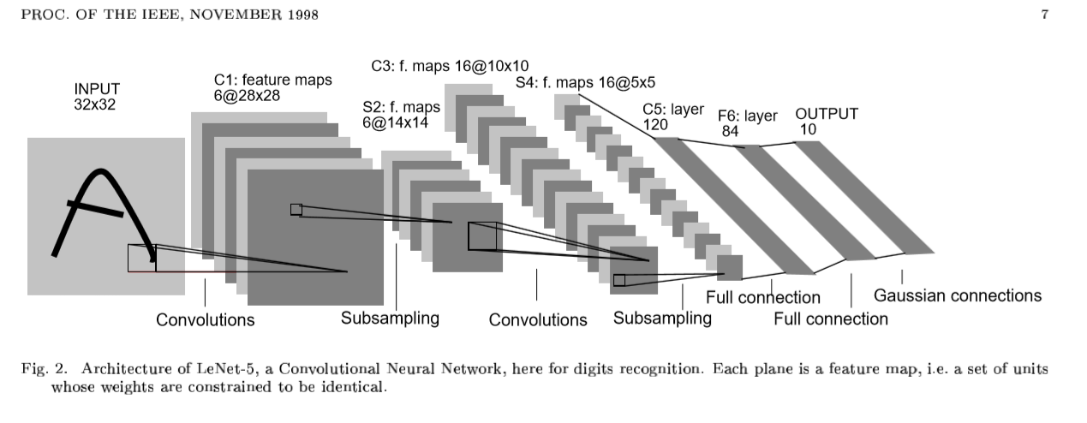
LENET ARCHITECTURE
The network used is called LeNet that was presented by Yann LeCun
Reference and photo credit: http://yann.lecun.com/exdb/publis/pdf/lecun-01a.pdf
C: Convolution layer, S: subsampling layer, F: Fully Connected layer

Slide 24
LENET ARCHITECTURE
STEP 1: THE FIRST CONVOLUTIONAL LAYER #1
Input = 32x32x1
Output = 28x28x6
Output = (Input-filter+1)/Stride* => (32-5+1)/1=28
Used a 5x5 Filter with input depth of 3 and output depth of 6
Apply a RELU Activation function to the output
pooling for input, Input = 28x28x6 and Output = 14x14x6
STEP 2: THE SECOND CONVOLUTIONAL LAYER #2
Input = 14x14x6
Output = 10x10x16
Layer 2: Convolutional layer with Output = 10x10x16
Output = (Input-filter+1)/strides => 10 = 14-5+1/1
Apply a RELU Activation function to the output
Pooling with Input = 10x10x16 and Output = 5x5x16
STEP 3: FLATTENING THE NETWORK
Flatten the network with Input = 5x5x16 and Output = 400
STEP 4: FULLY CONNECTED LAYER
Layer 3: Fully Connected layer with Input = 400 and Output = 120
Apply a RELU Activation function to the output
STEP 5: ANOTHER FULLY CONNECTED LAYER
Layer 4: Fully Connected Layer with Input = 120 and Output = 84
Apply a RELU Activation function to the output
STEP 6: FULLY CONNECTED LAYER
Layer 5: Fully Connected layer with Input = 84 and Output = 43
* Stride is the amount by which the kernel is shifted when the kernel is passed over the image.

Slide 25
NOTES ON SERVICE LIMIT INCREASE

Slide 26
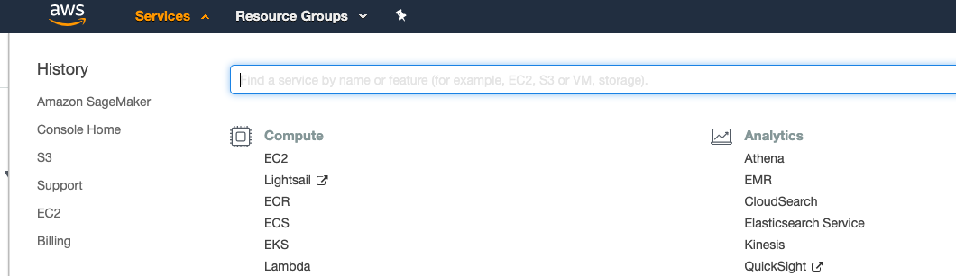
INSTANCE REQUEST
1. Click on Services
2.Click in Support

Slide 27
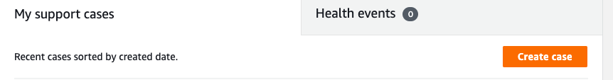
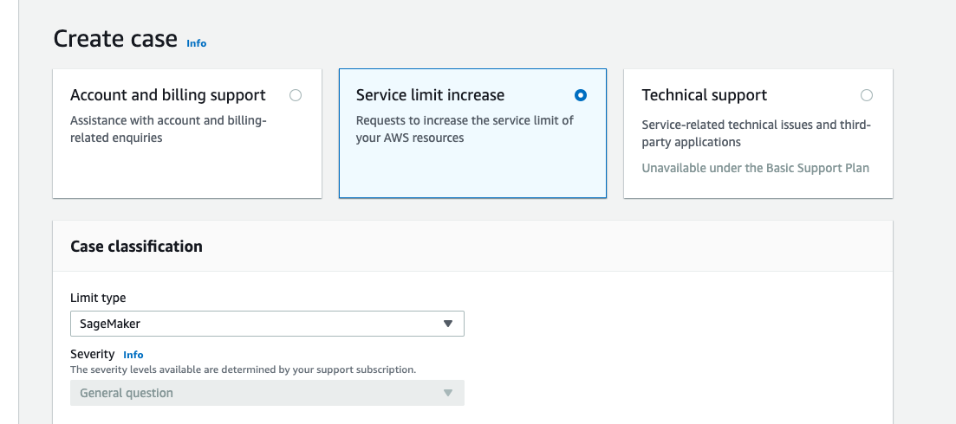
INSTANCE REQUEST
1.Click on Create Case
2. Select Service Limit Increase
3.Select Sagemaker from the drop-down box

Slide 28
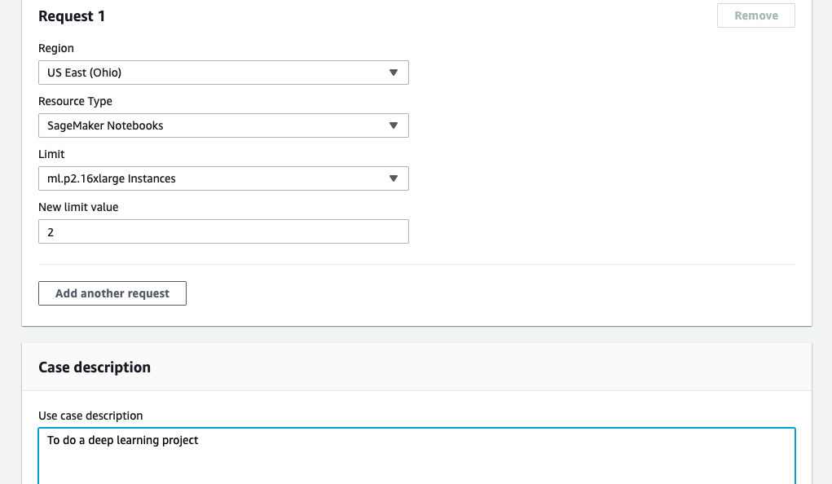
INSTANCE REQUEST
1.Select the region (region closest to you)
2.Select Sagemaker Notebooks
3.Select ml.p2.16xlarge instances
4. Request of 2( As we need 2 for training and deployment)
5. Give the same reason

Slide 29
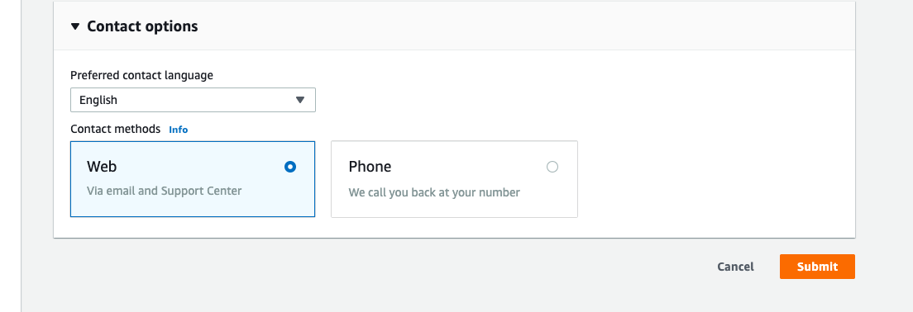
INSTANCE REQUEST
Click the submit button
NOTE: It takes around 24hrs to 48hrs for the instances to get approval for the first time. After that, you would get the instances approved within 1 – 2 hours.

